Slide 1

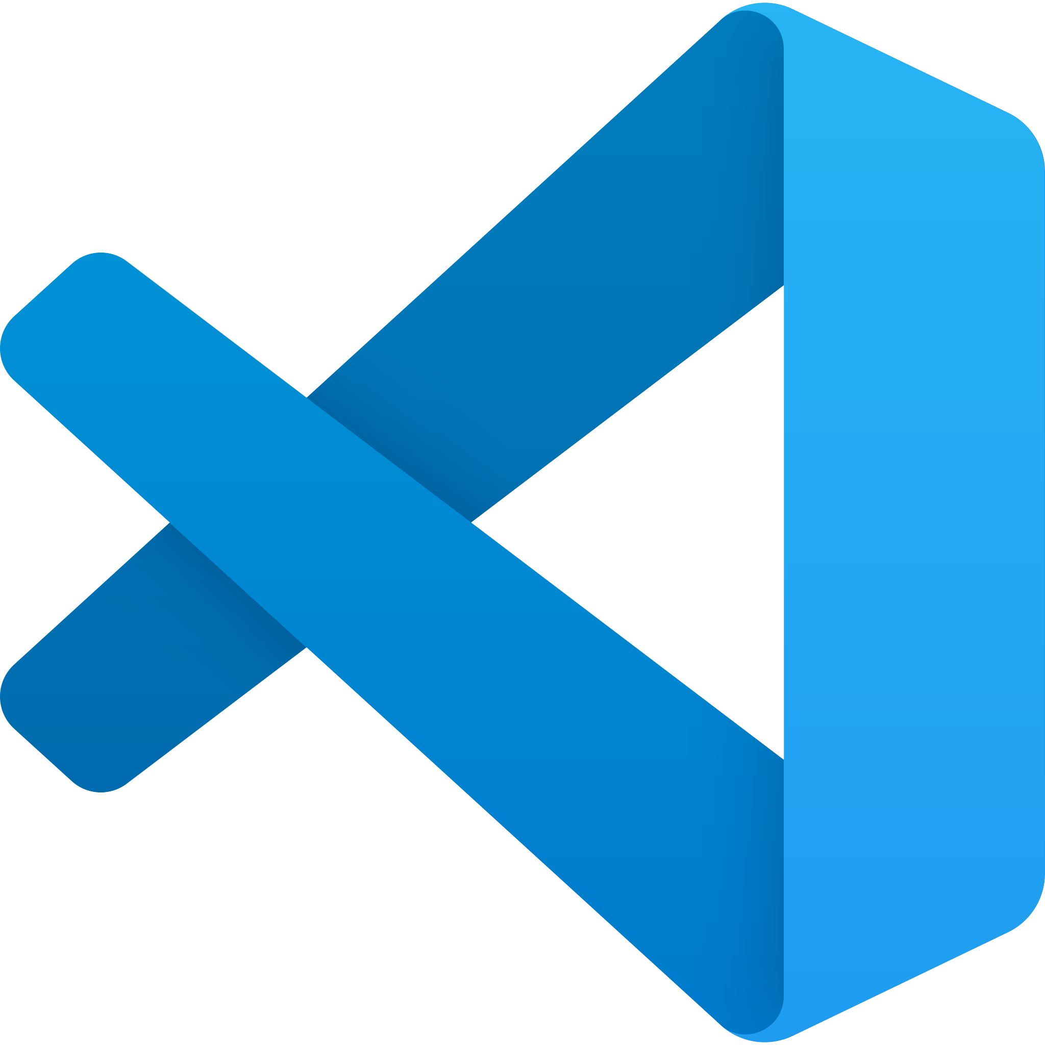

BEFORE WE START!
This is what you need to have installed before we start (If you want to follow along):
Node.js + express - npm install express
Postman
Code Editor (VS Code)
You’ll also need this repo on your local machine
https://github.com/JuaneX1/API-workshop

Slide 2
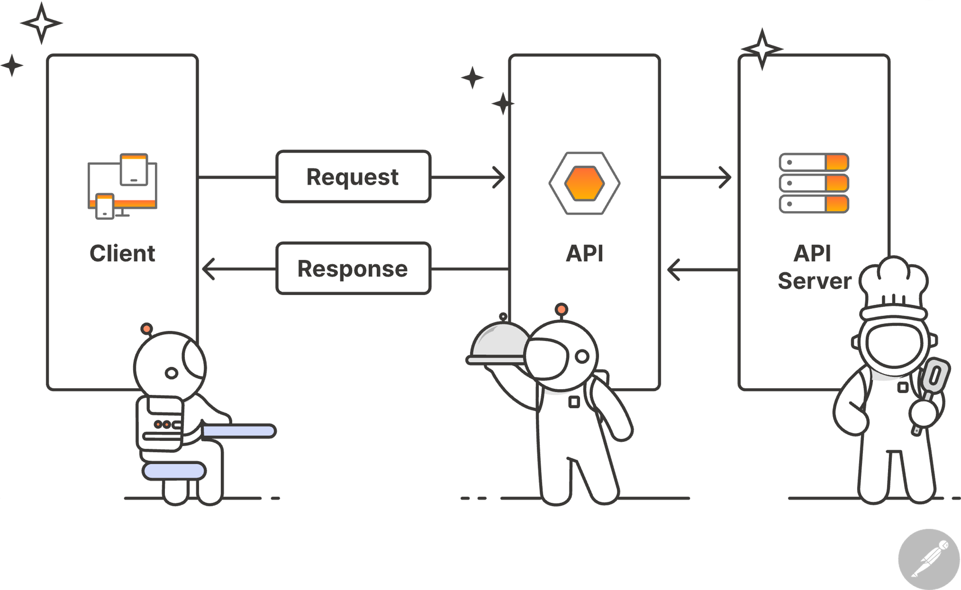

Intro to API’s
By: Juan Peñuela

Slide 3
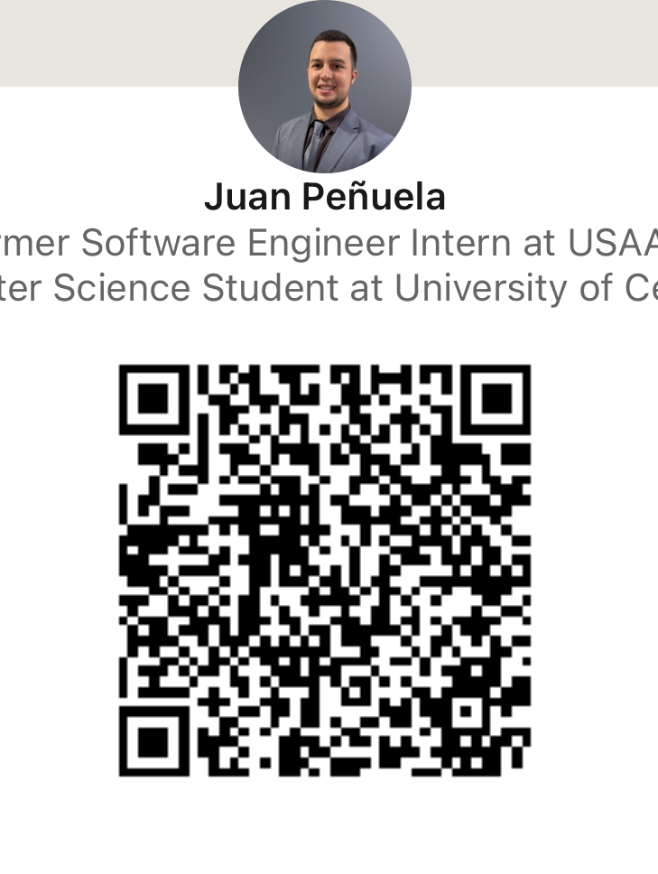

Juan Peñuela
Senior in C.S.
2x Intern at USAA
Incoming SWE Analyst at BNY

Slide 4

What You’ll Learn Today
What are API’s?
Why do we need to use API’s?
How do they work?
A few different types of API’s.
API methods (POST, GET, PUT, etc.)
What is Postman and how to use it?
Hands-on learning with a public API. (PokeAPI)

Slide 5
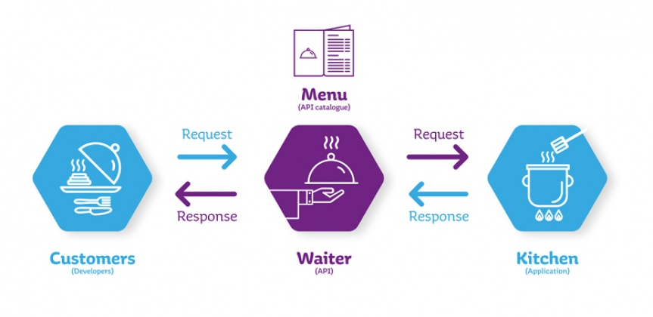
What are API’s and why do we use them?
APIs (Application Programming Interfaces) are sets of protocols that enable different pieces of software to communicate with each other and transfer data.
They are commonly used to bridge the gaps between different chunks of code to create powerful and secure applications that meet the user’s needs.

Slide 6
How Do They Work?
Client
Request
Server
The current server sends a request
The request is received, and its behavior will vary depending on the type
The server receives the request and generates a response
Response
The API response will generally include a status code, a header, and a body.
Endpoint | A specific URL that provides access to a resource
Method | The type of operation to perform
Parameters | Variables Passed on the request
Headers & Body | The general content for the request

Slide 7
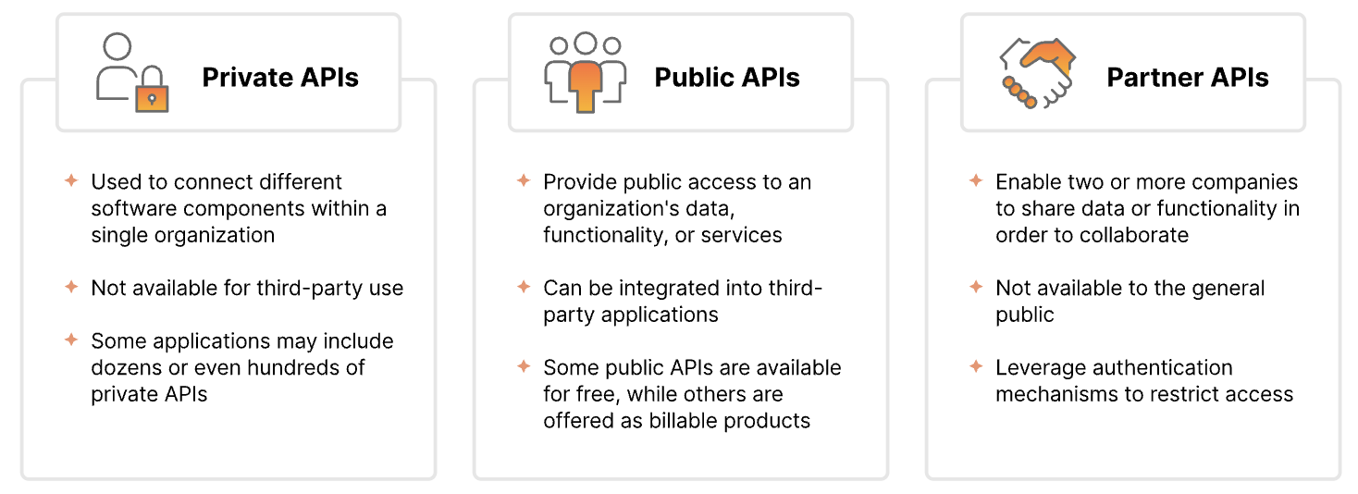
Different Types of API’s
Source: https://www.postman.com/what-is-an-api/

Slide 8
Different API Architectures
REST (Representational State Transfer) | Lightweight, stateless API design using HTTP methods and URLs, focused on resources.
SOAP (Simple Object Access Protocol) | A protocol-based, XML messaging format that supports complex operations and security features.
GraphQL (Query Language) | Flexible query language that allows clients to request exactly the data they need from an API.
Webhook | Event-driven API where one system sends real-time notifications to another system.
gRPC | RPC stands for Remote Procedure Call, and gRPC APIs were originated by Google. In gRPC architectures, a client can call on a server as if it were a local object.

Slide 9
API Methods
GET: Retrieves data from the server (e.g., fetching a resource or information).
POST: Sends data to the server to create a new resource (e.g., submitting a form or uploading data).
PUT: Updates an existing resource on the server with new data (e.g., editing a profile).
DELETE: Removes a resource from the server (e.g., deleting a record or file).
PATCH: Partially updates a resource on the server (e.g., updating one field of a record).
HEAD: Retrieves metadata (headers) about a resource without fetching the actual content.
OPTIONS: Requests the supported HTTP methods and other options for a specific resource or server.

Slide 10
DEMO!
Open the repo you cloned! (If you haven’t cloned it yet, the link is below)
If you haven’t done so already, you need the following installed to follow along:
Node.js + express - npm install express
Postman
Code Editor (VS Code)
You’ll also need this repo on your local machine
https://github.com/JuaneX1/API-workshop

